Slide 1
Miscellaneous Credits
Pub 4012 – Tab G
Pub 4491 – Part 5 – Lesson 27
Notes:
1
1
Slide 17: Added footnote, “unless taxpayers have never made improvements.”

Slide 2
Other Non-Refundable Credits
Retirement Savings Credit
Nonbusiness Energy Property Credit
Credit for the Elderly or Disabled
Nonrefundable – offset income tax only, no cash back

Slide 3
Retirement Savings Credit
Ask if taxpayer made (or plans to make) contribution to a retirement account
Might not show on any tax document
“Other” may include myRA contributions
  Eligible for retirement savings credit
  Can designate tax refund as a contribution and claim credit
Notes:
To claim the credit for a refund designation,
Account must be set up before the return is filed,
The trustee must be informed it is a contribution for the prior year, and
The deposit must occur before the filing due date.
If any of these doesn’t happen, the return must be amended to remove the credit.

Slide 4

Retirement Savings Credit
For low-income taxpayers who made contributions to qualified retirement plan
Review Decision Tree and Reminders
(page G-6)
Shown on Form 8880
TaxSlayer computes credit – verify input data

Slide 5

Retirement Savings Credit
Payroll contributions are entered on W-2 (page D-8)
Traditional IRA contributions are entered in Adjustment section (page E-5)
Roth IRA contributions are entered in Credits section (page G-7)

Slide 6
Retirement Savings Credit
Form W-2 Retirement Savings Contribution
  Entry in block 12 will generate Form 8880 automatically if qualified
  Entries in block 14 require taxpayer interview to see if entry qualifies for Form 8880 (must be a VOLUNTARY contribution)

Slide 7
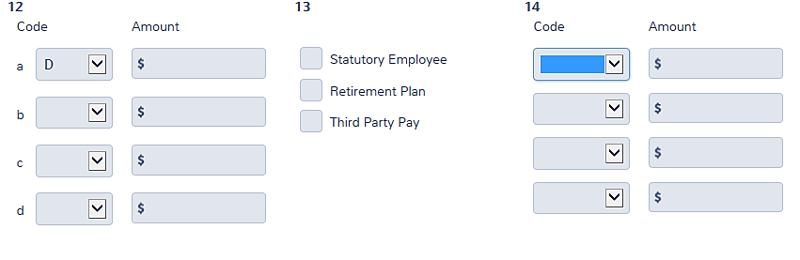
Retirement Savings Credit—W-2 Box 12
Codes D, E, G, AA*, BB*, and EE* will go to Form 8880
**These codes don’t show on the 8880 input screen

Slide 8
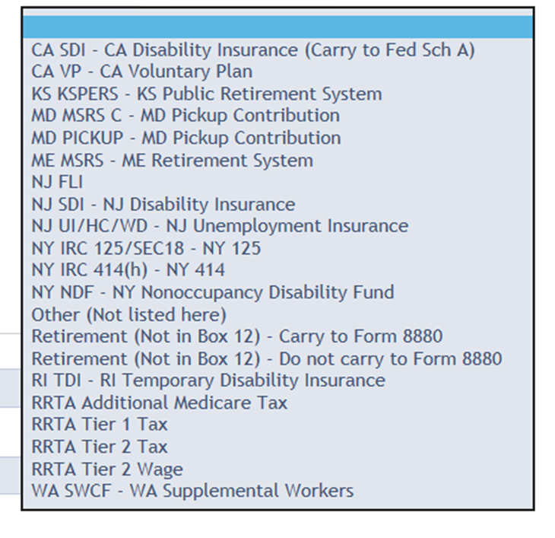
Retirement Savings Credit—W-2 Box 14
For voluntary contributions, choose this code
For mandatory contributions, choose this one

Slide 9
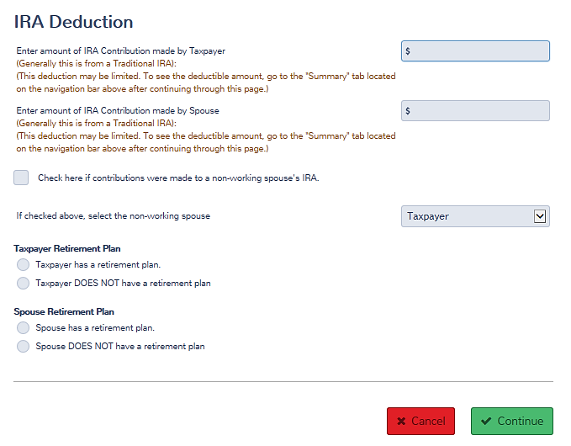
Retirement Savings Credit—Traditional IRA Contribution
Amounts entered in the Adjustment section carry to Form 8880*
**but don’t show on the 8880 input screen
Notes:
See Pub 4012 page E-5: TaxSlayer Hint

Slide 10
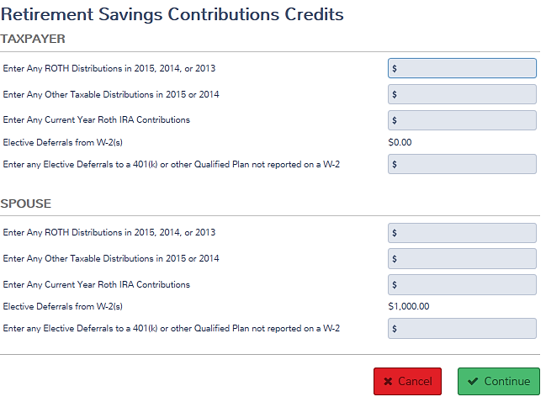
Form 8880
Enter Roth contributions
Enter distributions from current and prior years
Notes:
See Pub 4012, page E-5

Slide 11
Retirement Savings Credit—Distributions
Include all distributions except those listed on Pub 4012 page G-7
  e.g., some government plans have required contributions and do not permit elective contributions – distributions from those plans should not be input

Slide 12

Retirement Savings Credits
Questions?
Comments?
Notes:
12

Slide 13
Energy Related Improvements
Pub 4012 Page G-10
Note – solar electric, solar water heating, small wind energy, and geothermal heat pump property costs are out of scope

Slide 14
Residential Energy Credits
Nonbusiness Energy Property Credit extended but with limits
  Lifetime limits
    Cumulative $500 ($200 for windows) for all tax years after 2005
  Individual item limits
  Improvements to Main Home only
Notes:
A total combined credit limit of $500 ($200 limit for windows) for all tax years after 2005. If the total of non business energy property credits the taxpayer has taken in previous years (after 2005) is more than $500, the taxpayer cannot take the credit in 2016.

Slide 15
Residential Energy Credits
Pub 4012 Page G-10
Placed in service in current tax year
Energy efficient windows, doors, insulation, roof (materials only, not installation)
Heating, ventilating, and air conditioning, hot water heaters (materials and installation)
Compare item purchased with requirements from Form 5695 instructions
Notes:
Installed items must meet IRS requirements with regard to energy ratings in order to qualify for the credit. Taxpayers should have documentation showing that the requirements were met. Many HVAC systems that vendors sell taxpayers do not meet the minimum requirements.

Slide 16
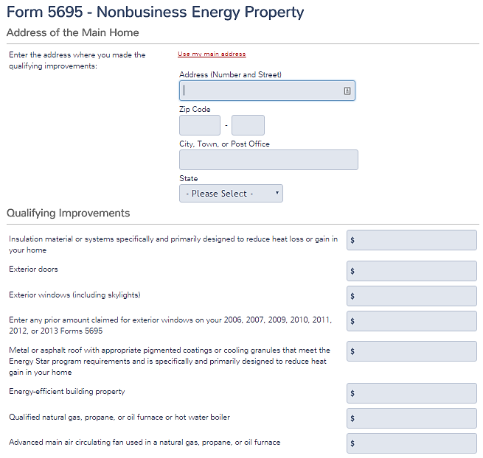
Residential Energy Credits
Review Form 5696 instructions to ensure compliance
Enter information in the Credits section

Slide 17
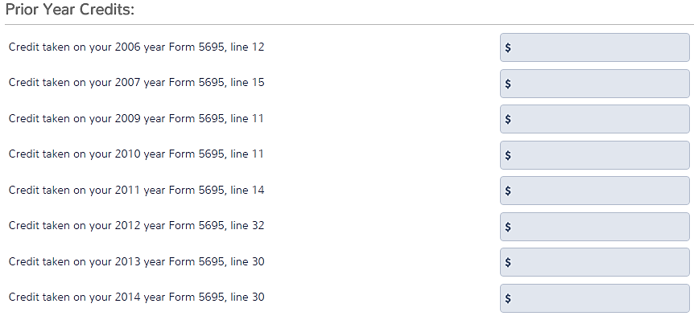
Residential Energy Credits—
Prior Year Credits
You’ll need the prior year returns*
*Unless taxpayers have never made improvements

Slide 18
Residential Energy Credits
Questions?
Comments?
Notes:
18

Slide 19
Elderly or Disabled Credit
Pub 4012 Page G-11
Non-refundable credit with low income thresholds
Very rarely occurs
Never for MFJ with only one qualifying person (AGI < $20,000 = no taxable income)
Notes:
Must meet ALL these requirements

Slide 20
Elderly or Disabled Credit
Pub 4012 Page G-11
Taxpayer (and spouse if MFJ) are age 65 or over, or retired on a taxable disability pension and under retirement age, and
Social Security < $5,000 ($7,500 MFJ—both disabled or 65+), and
AGI < $17,500 ($25,000 MFJ—both disabled or 65+)
Notes:
Must meet ALL these requirements

Slide 21
Elderly or Disabled Credit
From Credits menu, select Credit for the Elderly/Disabled and answer questions
Enter pension income not shown on Form 1040 (except not VA disability pension)
Notes:
TaxSlayer does not automatically generate Schedule R. Counselors need to understand the requirements and select Schedule R from the Credits menu if they feel the taxpayer may qualify for the credit.

Slide 22
Quality Review – Misc
Non-Refundable Credits
Confirm retirement contributions on
W-2 and those not on a tax document (IRAs) are properly captured
Ensure any retirement plan distributions have been recorded on Form 8880
Ensure energy credits don’t exceed cumulative limits
Verify if elderly or disabled credit is computed correctly (this credit is very rare)

Slide 23

Summary with Taxpayer
Review benefits of retirement contribution, if any
Review benefit of Credit for the Elderly or Disabled, if any
Review energy credits, if any

Slide 24
Miscellaneous Credits
Questions?
Comments?
Notes:
24

